Slide 1
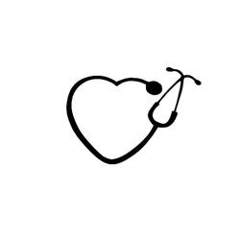
National Nurses Week 2019 NC Opioid Treatment Programs

Slide 2
National Nurses Week May 6 -12, 2019
We would like to thank our nurses for choosing addiction medicine as their nursing practice specialty.
Thank you for your dedication to our patients and for the sacrifices you make every day to make sure our patients receive the highest quality patient care.
- NC Opioid Treatment Programs

Slide 3
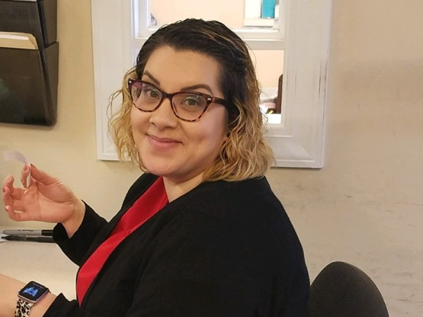
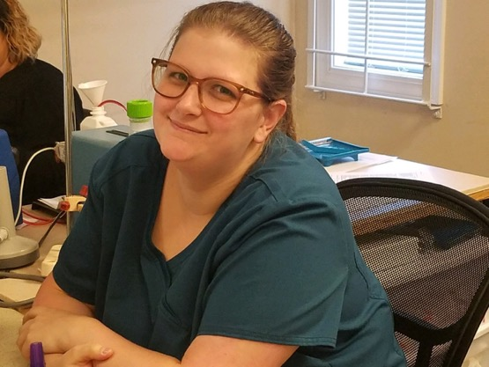
“Addiction medicine nurses are strong enough to tolerate everything and soft enough to understand everyone.”
-Anonymous

Slide 4
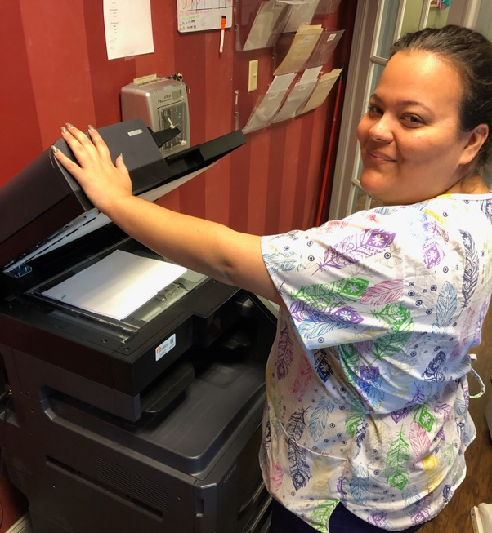
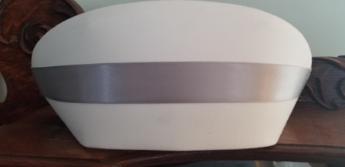
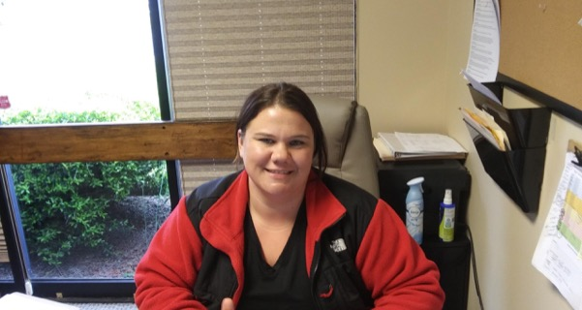

Slide 5
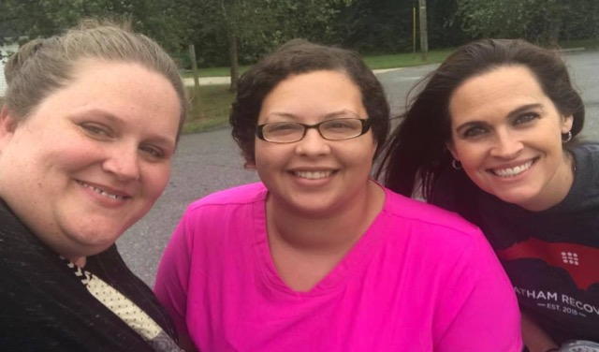
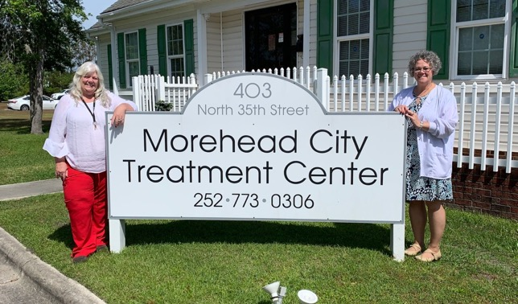
North Carolina Opioid Treatment Program Nurses are comprised of Licensed Practical Nurses (LPN), Associate Degree Nurses (ADN), Bachelor of Science in Nursing (BSN) and Master’s of Science in Nursing (MSN).

Slide 6
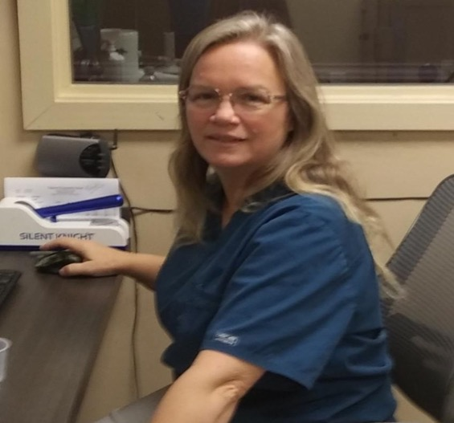
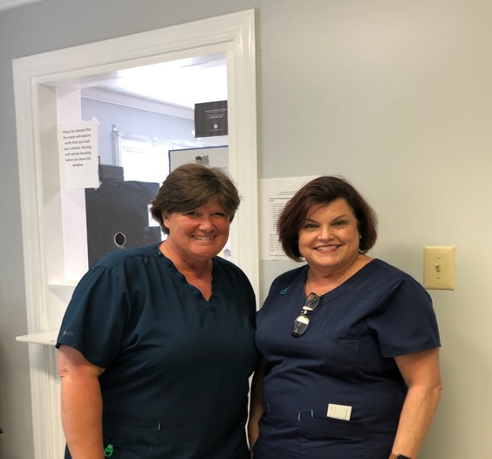
Nurses were rated by the public, highest for honesty and ethics of all professions for the 17th consecutive year. (Stone, 2019).

Slide 7
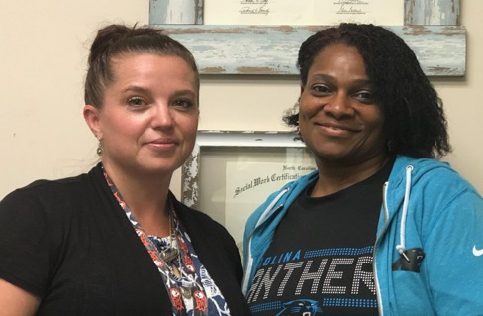
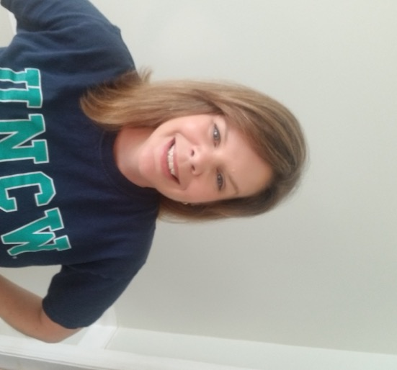
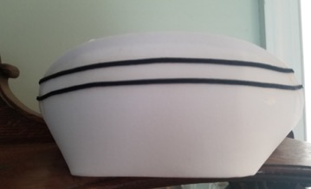
North Carolina Opioid Treatment Program Nurses treat over 20,000 patients every year.

Slide 8
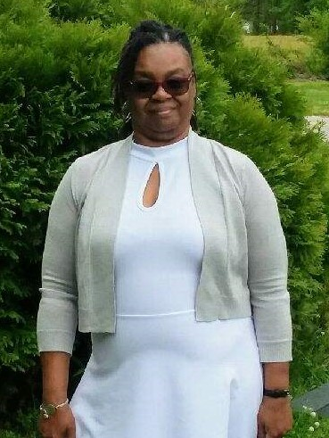
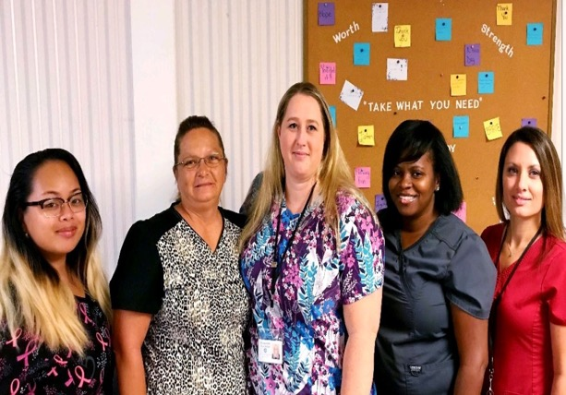
There are 4 million nurses in the United States.

Slide 9
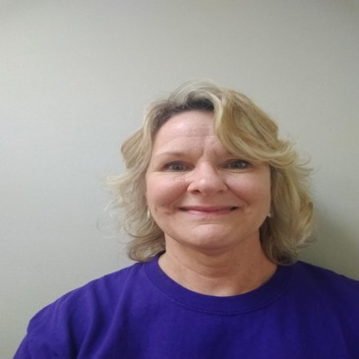
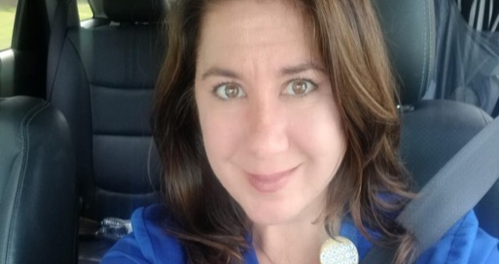
The Nightingale Pledge
I solemnly pledge myself before God and in the presence of this assembly, to pass my life in purity and to practice my profession faithfully. I will abstain from whatever is deleterious and mischievous, and will not take or knowingly administer any harmful drug. I will do all in my power to maintain and elevate the standard of my profession, and will hold in confidence all personal matters committed to my keeping and all family affairs coming to my knowledge in the practice of my calling. With loyalty will I endeavor to aid the physician in his work, and devote myself to the welfare of those committed to my care.

Slide 10
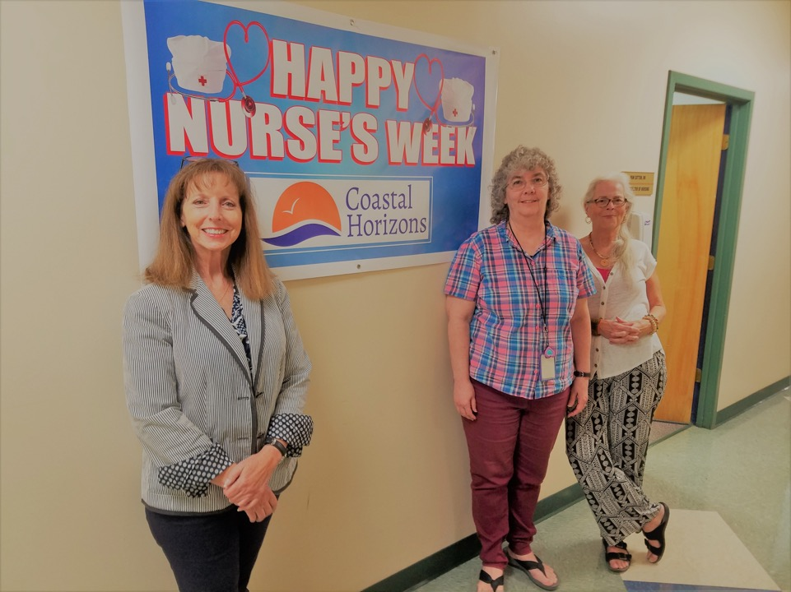
“Nurses dispense comfort, care, and compassion daily.”

Slide 11
Please take a moment to visit the MAT Nursing Network at www.NCATOD.org.

